Slide 1
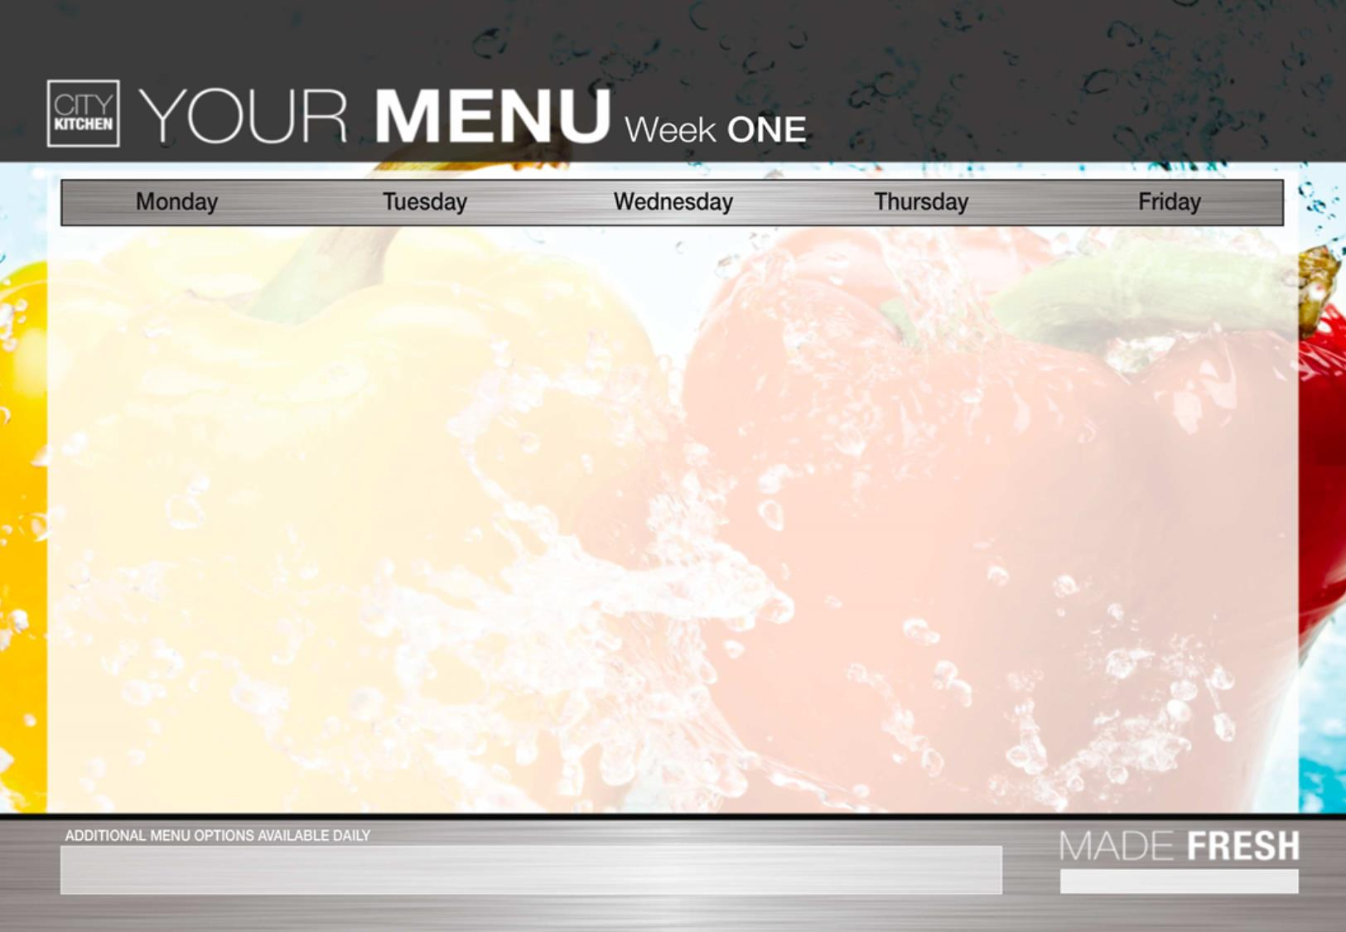
Fish Cakes Diced Potato Creamy Macaroni Cheese | Pork sausage Vegetable sausage Mash potato | Roast Chicken Or Quorn Fillets Yorkshire Pudding & Gravy | Chicken meatballs Quorn meatballs Tomato sauce | Homemade Cheesy Pizza Fish fingers
Seasonal Vegetables | Baked Beans Peas | Creamy mash Potatoes Roast potato Seasonal Vegetables | spaghetti Seasonal Vegetables | Chunky Chips Baked Beans Peas
Fresh Seasonal Salad Bar With Bread Available Daily
Strawberry jelly Yoghurts Fresh Fruit | Assortment of fresh fruit or Yoghurt | Iced Sponge Yoghurts Fresh Fruit | Assortment of fresh fruit or Yoghurt | Ice Cream Jelly Yoghurts Fresh Fruit
Vegetarian options available daily.
For any allergen/dietary requirements please speak to the Catering Supervisor

Slide 2
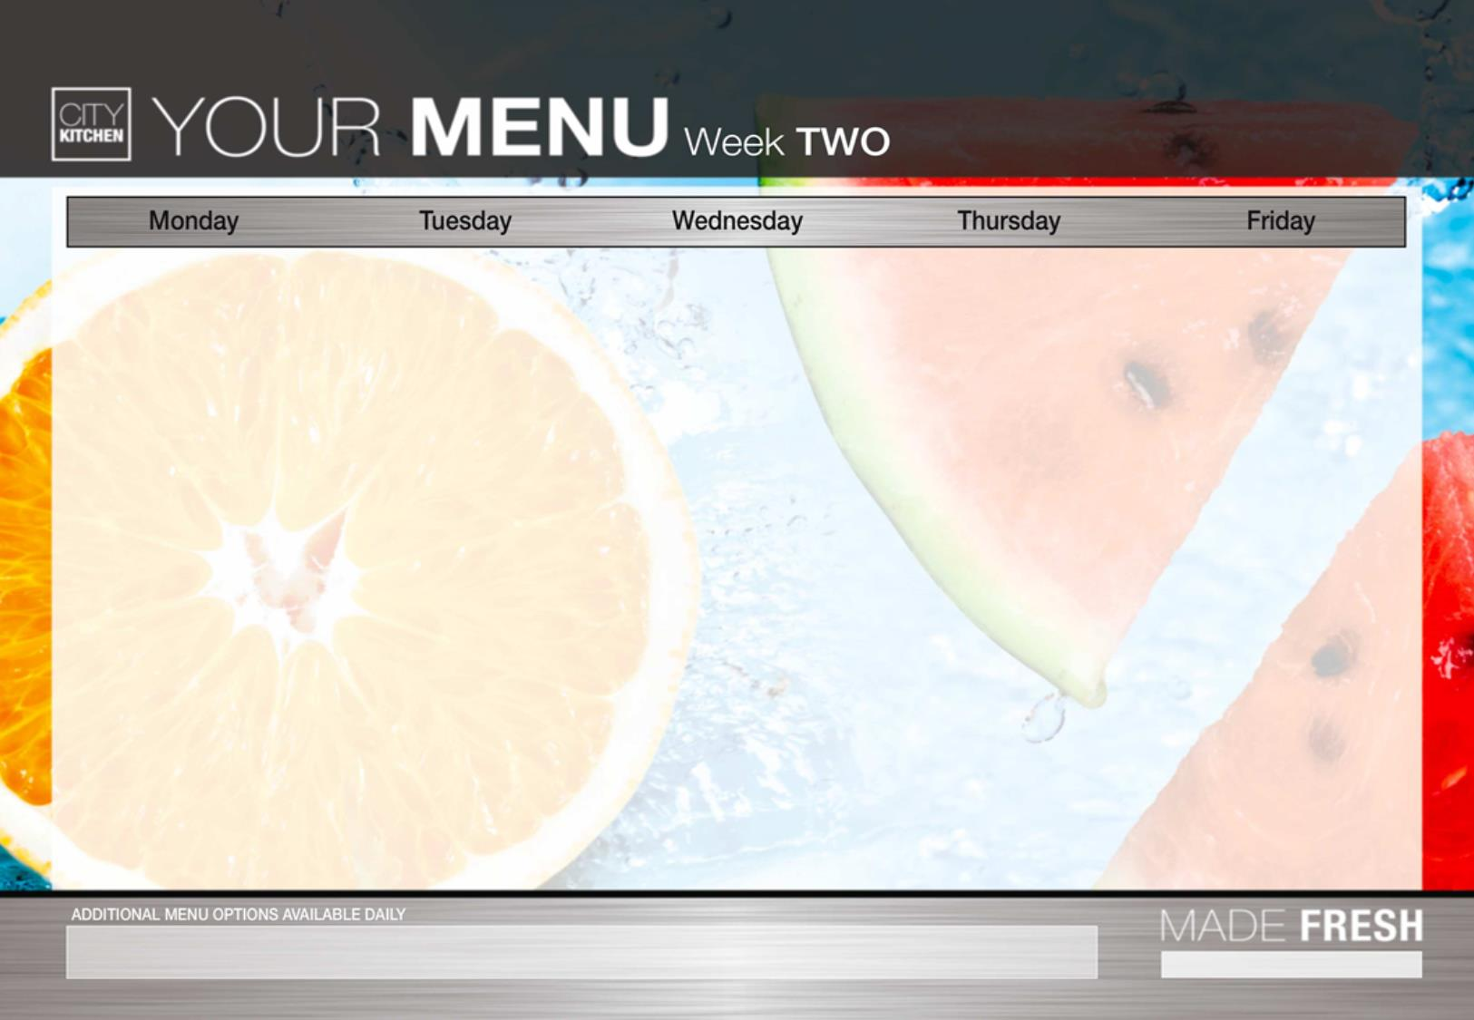
Vegetable crumble Quorn nuggets Diced potato | Beef Burger Quorn burger | Roast Chicken Or Quorn Roast Yorkshire Pudding & Gravy | Salt and pepper chicken Vegetable spring roll Curry Sauce | cheese Pizza Fish goujons
Seasonal vegetables | Wedges Baked Beans Seasonal Vegetables | Creamed Potatoes Roast potato Seasonal Vegetables | Egg noodles Seasonal Vegetables | Chips Baked Beans Seasonal Vegetables
Fresh Seasonal Salad Bar With Bread Available Daily
Strawberry Mousse with Sprinkles Yoghurts Fresh Fruit Selection | Assortment of fresh fruit or Yoghurts | Chocolate shortbread Yoghurts Fresh Fruit Selection | Assortment of fresh Fuit or Yoghurts | Ice Cream Assorted Yoghurt Fresh Fruit Selection
Vegetarian options available daily.
For any allergen/dietary requirements please speak to the Catering Supervisor

Slide 3
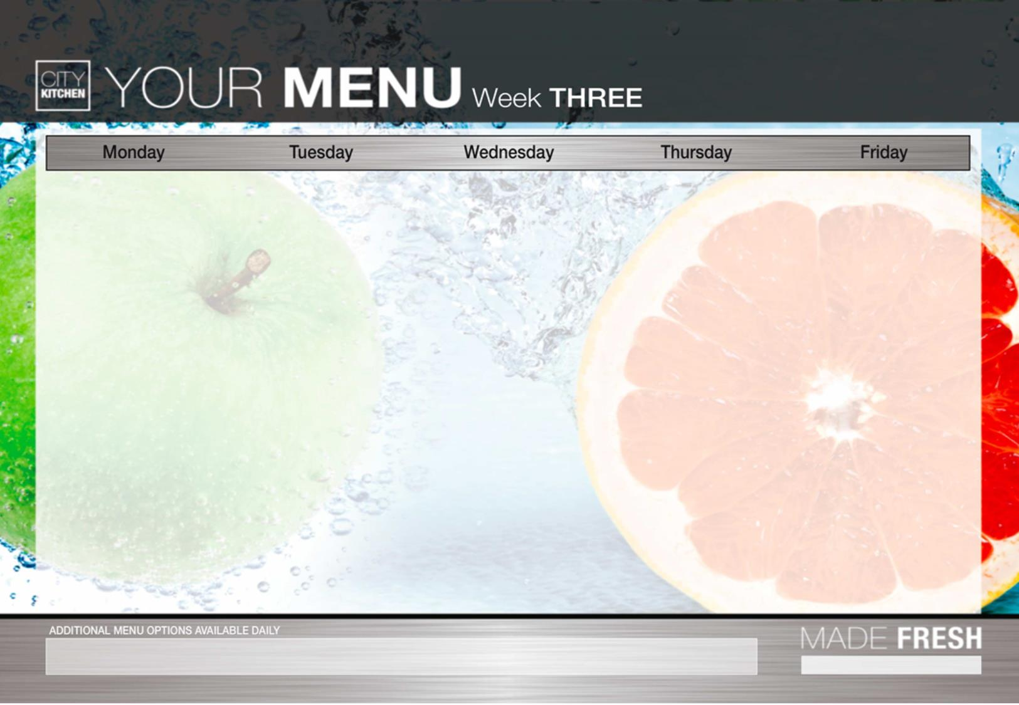
Vegetable bolognaise Cheese and potato pie | Chicken goujons Quorn goujons | Roast Beef or Quorn Roast Yorkshire Pudding & Gravy | Sticky Chicken Sticky Quorn | Homemade Margarita Pizza Fish fingers
Spaghetti Seasonal Vegetables | Diced potato Beans Seasonal Vegetables | Roast potato Seasonal Vegetables | Sweet and sour sauce Rice Seasonal Vegetables | Chips Baked Beans Seasonal Vegetables
Fresh Seasonal Salad Bar With Bread Available Daily
Jelly Yoghurts Fresh Fruit Selection | Assortment of fresh fruit or Yoghurts | Toffee sponge Cake Yoghurts Fresh fruit selection | Assortment of fresh fruit or Yoghurts | Ice Cream Jelly Yoghurt Fresh Fruit Selection
For any allergen/dietary requirements please speak to the Catering Supervisor

